Slide 1
Need CE credit for this
session?
Please don’t forget to
scan in to have your
attendance tracked.

Slide 2
Challenges in the application of ACT in clinical psychiatric settings

Slide 3
ACT training in a psychiatric ward
Clinical experiences and staff-patient outcomes
Mårten Tyrberg, MSc, PhD student, marten.tyrberg@psychology.su.se
Per Carlbring, Professor
Tobias Lundgren, PhD

Slide 4
The antecedents
The shape of psychiatric inpatient care.
The suffering of the severely mentally ill.
CBT-based psychosocial interventions seem promising in the context, but little systematic outcome data.
ACT trainings shown promise in other, but similar populations.
Our own pilot (Tyrberg, Carlbring & Lundgren, in press)
Notes:
Western Europe and Scandinavia at least. Individual patient, individual staff, society. Little direct patient contact, little therapeutic talk.

Slide 5
Notes:
Individual level: being specific and concrete, connection between training and actual work in the ward. Ward level: support from the ward manager, tailoring training to skill mixes in the ward. Organizational level a bit trickier. Fostering a learning culture?

Slide 7
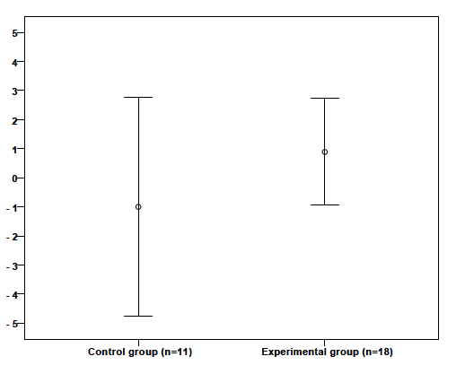
Figure 1. 95% CI’s around mean difference between
pre- and post-workshop WAAQ ratings for control and
experimental ward participants. Positive scores indicate
increased psychological flexibility.
Notes:
Controls (n=11): -1.00. Experimentals (n=18): 0.89.
Om vi drar från populationen, kommer intervallet i 95% av fallen inkludera det verkliga populationsmedelvärdet. Den centrala delen av CI fångar oftare det sanna medelvärdet.

Slide 8
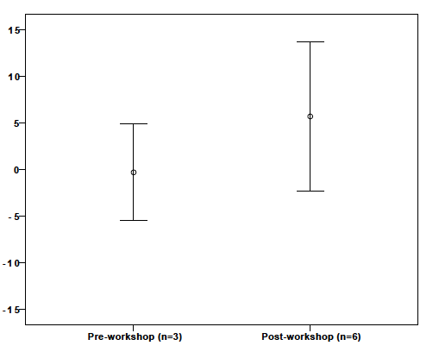
Figure 2. 95% CI’s around the mean difference between
intake and discharge AAQ-II ratings for patients treated
pre- and post-workshop intervention. Positive scores
indicate increased psychological flexibility.
Notes:
Pre (n=3): -0.33. Post (n=6): 5.67.

Slide 9
Figure 3. Example of staff member displaying variability in daily ratings of ACT-consistent behavior. Higher scores indicate higher levels of ACT-consistent behavior, with a maximum score of 36.
Notes:
Statements: I have encouraged a patient to have his/her voices, thoughts or feelings, without resistance; I have helped a patient be in the present; I have talked to a patient about what he/she misses in life; I have approached and talked to a patient despite being unsure of how to help him/her.
Obs exempel på några, syftet att mäta nära. Obs inga generella slutsatser.

Slide 10
Figure 4. Example of staff member displaying increasing slope in daily ratings of ACT-consistent behavior in baseline phase, and decreasing slope in intervention phase. Higher scores indicate higher levels of ACT-consistent behavior, with 36 being the maximum score.

Slide 11
Figure 5. Examples of staff members displaying low levels of daily self-rated ACT-consistent behavior in baseline phase, and higher levels in intervention phase.

Slide 12
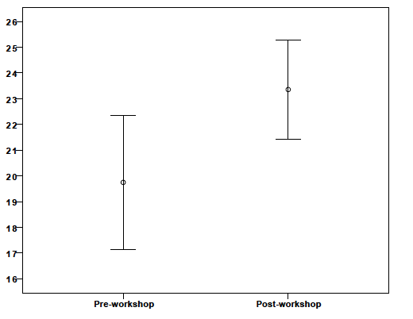
Figure 6. Comparison of staff (n=22) mean pre- and post-workshop ratings on the Open Aware Active (OAA) measure. Error bars represent 95% CI’s.
Notes:
N=22. Mean 19.75 → 23.35.

Slide 13
Why these results?
WAAQ: Staff already happy?
AAQ: Inherently unstructured environment
Self-ratings: Other variables overshadow potential learning effects? Need to explore individual experiences?
Individual level, ward level and organizational level challenges (Rosebert & Hall, 2009).
Valid self-rating measure?
Notes:
Motivation (I), pre-existing knowledge (I), workload on the ward (W), occupated beds (W), admissions and discharges (W), staffing of doctors (W/O), other projects run simultaneously (O)

Slide 14
Take-home
In-depth understanding enabling practical usage of the model requires persistence, on the part of both trainer and trainee.
Notes:
Before, during, and after implementation. Model more difficult to learn than we expected? Presence on the ward. The organization has to help.

Slide 15
marten.tyrberg@psychology.su.se

Slide 16
Need credit for this session?
Please don’t forget to
scan out.
What did you think?....
complete the 3 question quickeval
for this session at
https://contextualscience.org/quickeval
This was presentation was session #39

